Slide 1
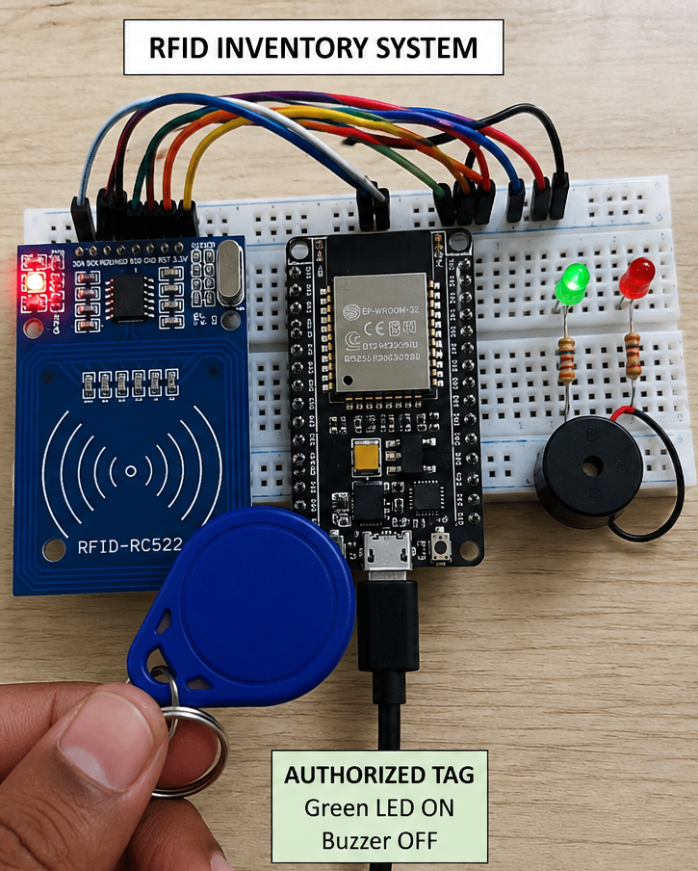
RFID Based Inventory Management System
Team member
Yugraj singh
Harshvardhan singh

Slide 2

The Problem with Traditional Inventory Management
Manual stock counting
Human errors
Time-consuming process
Inventory mismatch
Poor tracking efficiency

Slide 3
The Prototype
Component | Purpose
ESP32 | Main controller
MFRC522 RFID Reader | Reads RFID tags
RFID Tags/Cards | Store item IDs
16×2 LCD Display | Displays inventory status
Breadboard | Circuit assembly
Jumper Wires | Connections
LED | Status indication
Buzzer | Alert notification
USB Cable | Arduino programming
Arduino IDE | Software development
We selected an RFID-Based Inventory Management System because it provides automatic identification and tracking of inventory items without manual scanning.
Our prototype is a scaled functional model, not a full industrial system.

Slide 4
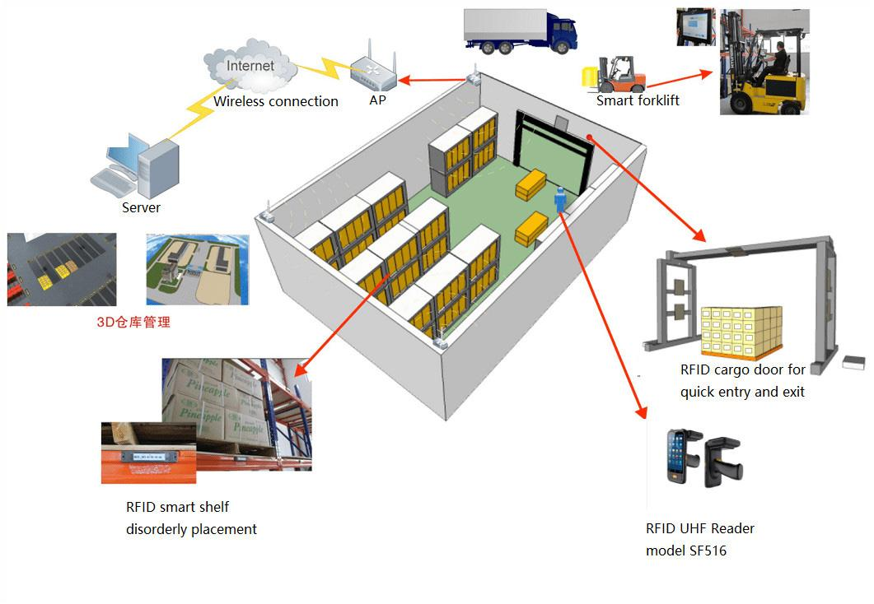
Benefits
Eliminates manual stock counting
Minimizes human errors
Saves time and labor costs
Supports Industry 4.0 automation
Easy to implement and expand

Slide 5
Testing The Prototype
RFID tag detection
Inventory identification
Automated tracking process
The small-scale model provided enough information to understand system behavior and validate the design before developing a larger industrial solution.

Slide 6
Final Result
Does the Final Prototype Solve the Problem?
The RFID-Based Inventory Management System successfully addresses the problems of manual inventory tracking by:
Automatically identifying inventory items using RFID tags.
Reducing human errors.
Providing faster inventory updates.
Improving inventory visibility and management efficiency.

Slide 7

Future Improvements
IoT + Cloud Integration
Mobile App
Smart Warehouse Implementation
Long-range RFID readers
Real-time analytics dashboard

Slide 8
Thank you

